Slide 1
Capacity forecast on DALI data.
Spa
rk
Bram Vonk, JADS-Enexis
June 29 2021

Slide 2
Inhoud komend half uur
Korte introductie project (5 min)
Project opzet en werkwijze (5 min)
Resultaten eerste sprint
Waarde (5 min)
Data (5 min)
Model (5 min)
Discussie (4 min)
Werk komende sprint (1 min)

Slide 3
Aanleiding
Vraag netverantwoordelijken Q3 2020
Kan met DALI data trafo overbelasting voorzien worden?
Nu JADS opleiding waarin dit vraagstuk goed past.
Probleem
Door energietransitie forse boost opwek en belasting (groei extremen)
Niet meer afdoende reactief (sleepwijzers of DALI) verzwaringen in te plannen.
Dit raakt de leveringszekerheid, veiligheid en versnelt de energietransitie niet.
Project doel
Forecast 6-12 maanden vooruit de capaciteitsvraag op basis van DALI data.

Slide 4
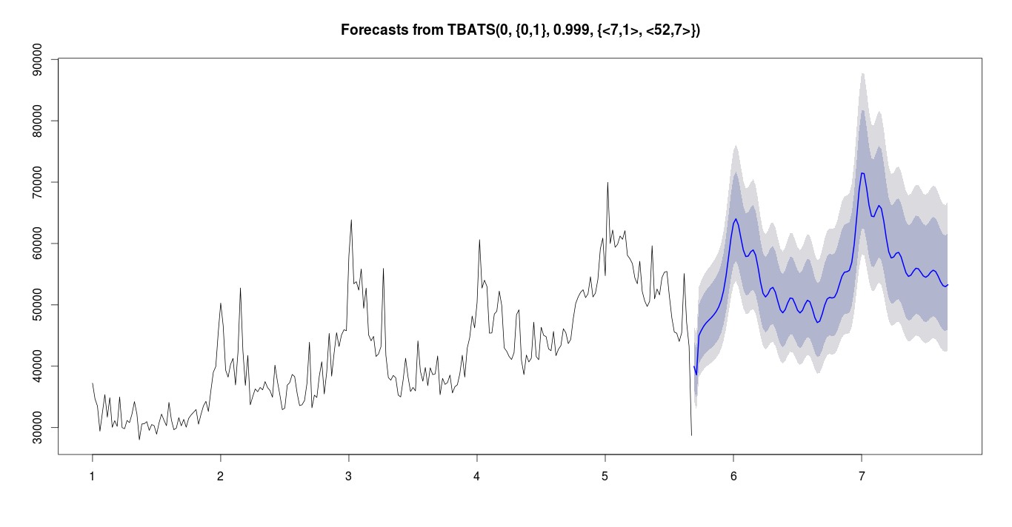
Vergezicht oplossing
Voorbeeld:
In de herfst kunnen bepalen met bepaalde zekerheid of er in de lente issues komen.
transformer limit
transformer
loading
autumn
spring
historic data
forecast

Slide 5









Project actoren
supervision / support JADS
Grid Planners/Users
3wk
Academic Director
PDEng student
Me
support Data Science Team
3wk
Data Engineers
Business / Mngmnt

Slide 6
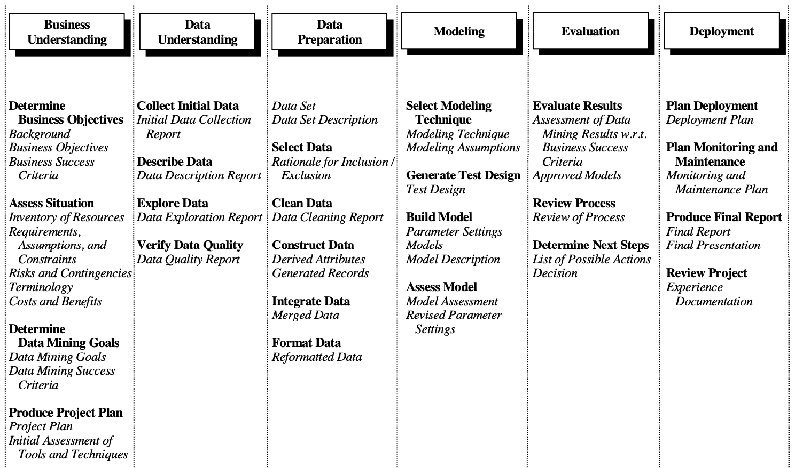
Way of Working vanuit Data Science/JADS: CRISP-DM
Business Understanding
Data Understanding
Data Preperation
Modeling
Evaluation
Deployment

Slide 7
Focus afgelopen sprint (documented in report)
Business Understanding
Data Understanding
Actions Bram (partly done)
Check data access / quality
Suggestion for robustness data.
Input Grid Planners:
Tips / GO with suggested approach on data
Actions Bram
Report on Business Value
Flow down slides
Check from Grid Planners
Requirements
Flow down slide
Actions Bram (done)
First thoughts on modelling

Slide 8
Flow Down Business value
Business Value
Safety
Reliability
Affordability
Sustainability
Company KPI
Overloading
Outage
Claims
Ad hoc resources
Planned resources
Project KPI
Do nothing
Ad hoc replacement
Stop growth
Planned replacement
Possible actions
Optimal planning transformer replacement
Model Usage
Forecast Model
foreseeing transformer overload
Model result
Future power timeseries DALI
Y variables
Nominal power transformer
Historic power timeseries DALI
X Variables

Slide 9
Requirements for achieving value
Model
Explainable
Forecast has prediction intervals
Forecast horizon 6-12 months
Uses prior information of population (if data is limited)
Usage tool
No separate log in/install
Quick visualisation of results (no waiting)
Scalable up to 35k transformers
Sorting on urgency
Reliable (tool + forecast)
Export results possible for other tools (e.g. Vision, Power BI dashboards)

Slide 10
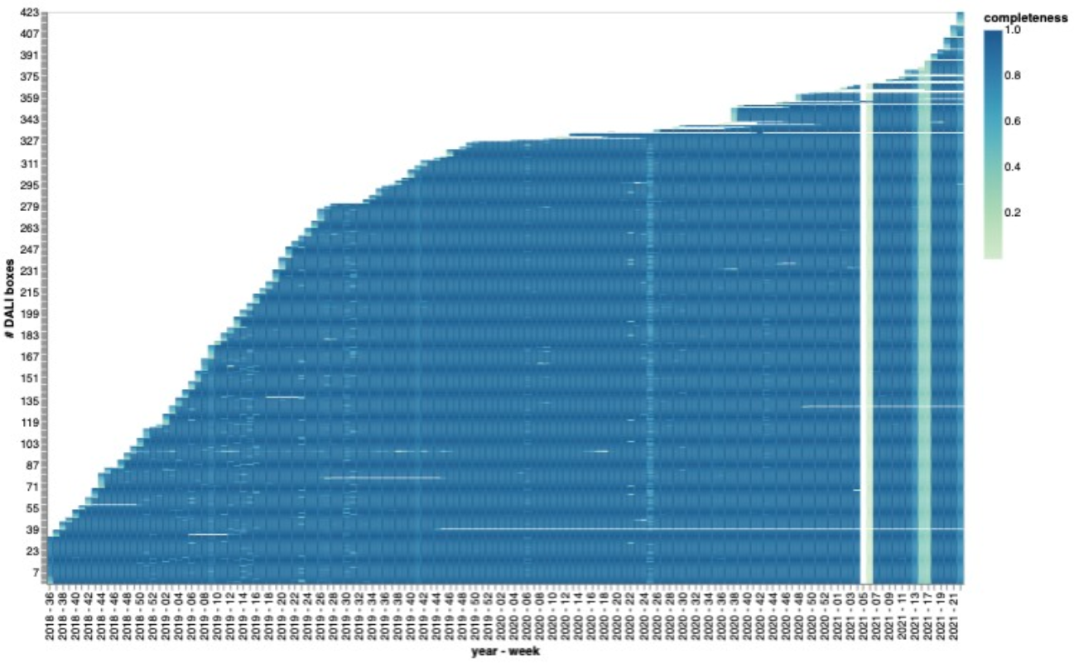
Data
(meta)data available (queried)
Source: Athena → Snowflake
15 minute averages (per phase and sum)
Data since 2018 (growing pop. → 8k)
Proposal:
10 transformers for PoC
Scale to 423 for development + test
End product testing on 8k (dummy 35k)
Data quality
Completeness issues
ETL issues, data expected to be there later.
Concept preprocessing:
3 most extreme S values per week, transformer, phase
More robust + eliminates week seasonality
Storage result: AWS S3, parquet

Slide 11
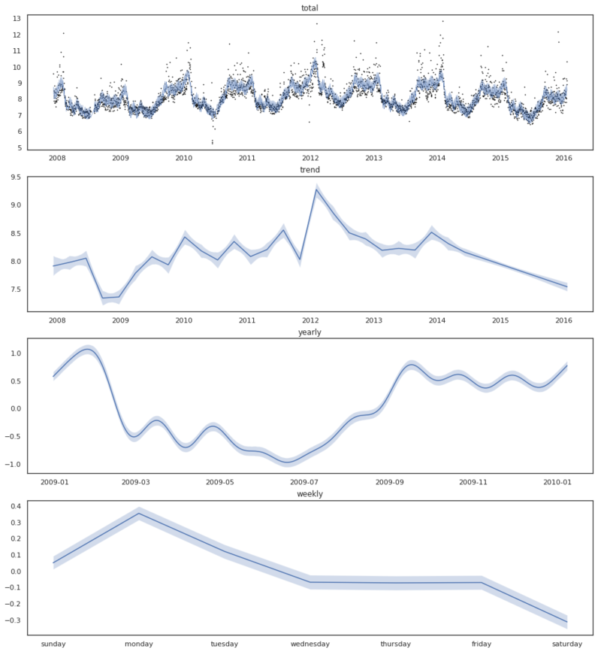
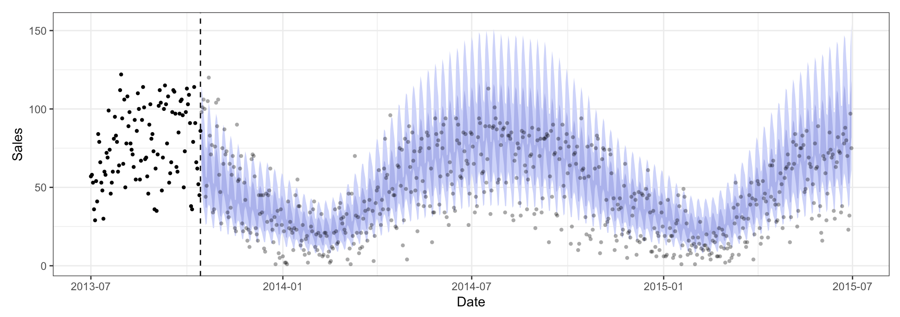
Model
Probabilistic approach
Enables prediction interval
Computational burden?
Able to deal with prior knowledge
Package / language (via python)
Pymc3 (bit familiar with)
Stan
(Edward)
Generalized Additive Model
yearly season + piecewise trend + (error)
Explainable

Slide 12
Discussie

Slide 13
Focus komende sprint
Business Understanding
Data Understanding
Input verwerken vandaag
Verder op Data Understanding
Over 3 weken:
Beslissing of data voldoende business waarde kan toevoegen → GO / NO GO

Slide 15

measurements
← $≥$ 2 year →
← forecast horizon →
train set
test set

